Slide 1
Cineteca di Bologna
Project Management Highlights
Francesca Mangialardo 0000904129
Carlo Teo Pedretti 0000903167
Mattia Spadoni 0000906249

Slide 2
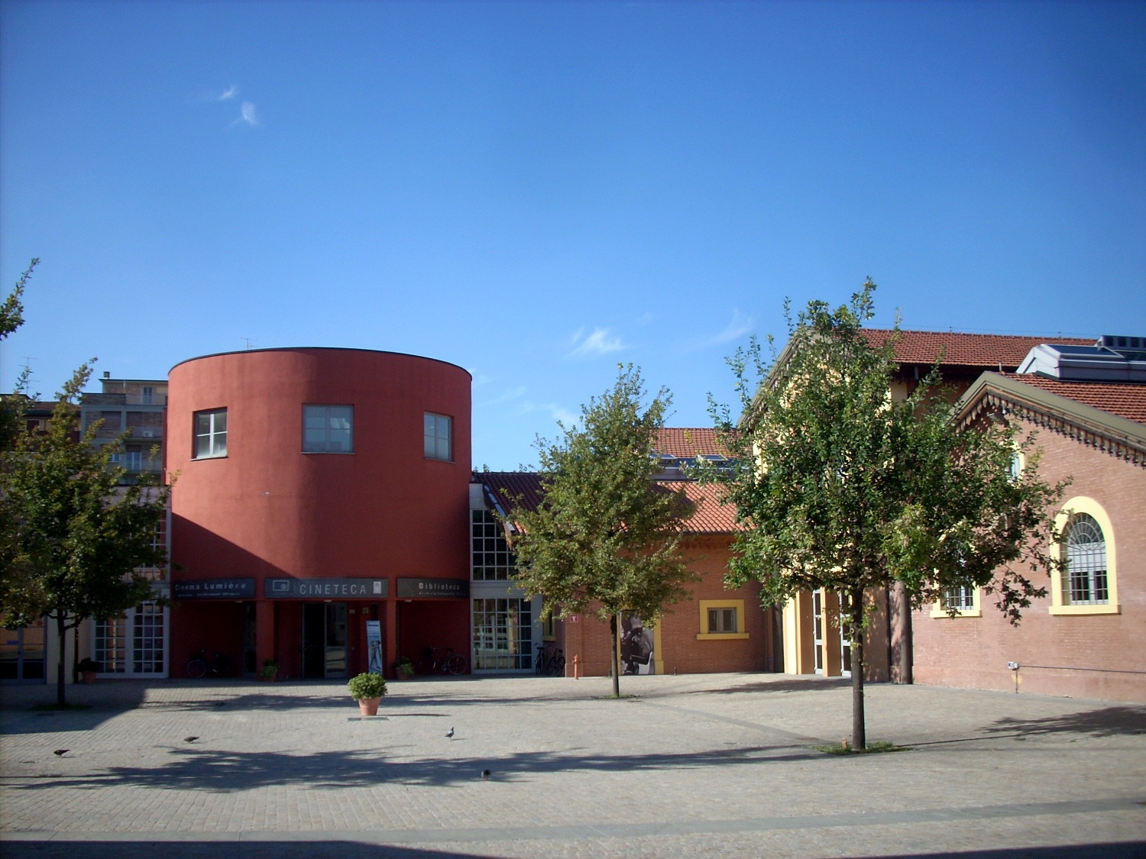
The client
Fondazione Cineteca di Bologna is a place for archival conservation and restoration, film and audiovisual promotion and dissemination, training, research, and publishing in an era of immense technological, aesthetic and social change.
Notes:
matti, 3 funzioni: archivistica, audiovisuale, formazione.

Slide 3
The problem
The Cineteca website provides an online ticket purchase service that is not currently used by a specific target of users.
These users go to the cinema and prefer purchasing the ticket in loco. But why?
We were asked to understand the users and find a way to motivate them in the use of the online service provided by our client
The solution should not upset that part of the audience that the organization already reaches and addresses satisfactorily.
Notes:
fra

Slide 4
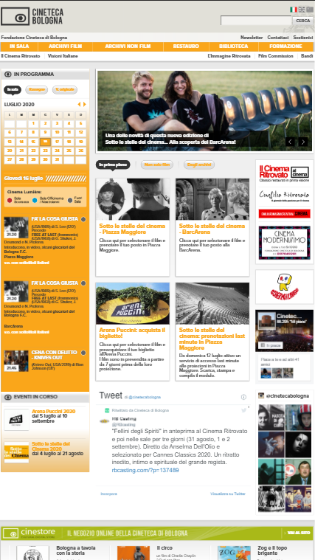
The analysis
We identified some major problems in the information architecture of the Cineteca website, starting from the unclear identification of the Cinema Lumière as their official theater.
The website is also not optimized for mobile view.
We believe that users are currently charged with a heavy individual cognitive load that can be lightened.
Notes:
teo

Slide 5
Who are the users? Goals and needs
Our users are young people between 14 and 24 years old that are fairly organized and curiously looking for external stimuli. They easily get distracted and bored, they don't want to lose their time. They use devices and online services only for specific activities.
Cinema is perceived as a moment of relax and escape from everyday life
Going to cinema is an highly social activity
They want to find information quickly
They want to use their smartphone without having to download an app
They enjoy simple and essential websites
Notes:
matti. Users curiosi, distraibili e facilmente annoiabili+ relax+socialità+poca pazienza+uso quasi esclusivo di download+piacciono siti semplici

Slide 6
How are competitors doing?
Chaotic information presentation
(Visual) contents excess
Non intuitive nor explained functionalities
Simple and frequent tasks are cognitively demanding
Information retrieval does not satisfy users expectations
Missing consistency in terms and symbols
Notes:
fra

Slide 7
Feasibility study
We created five personas to represent our target users focusing on their goals, motivations, behaviour and attitudes towards the service.
We also created three scenarios in which our personas find themselves happy and motivated to use the tool in a certain context of use.
Using this approach we were able to foresee issues and drive the design process.
Notes:
teo scenari: 3 utilizzi concettualmente differenti del sito: 1) Persona che va in compagnia e vuole sapere i prezzi, ma senza un forte link con il film 2) persona con forte link emotivo al film e va da sola 3) persona stupida che ha bisogno di informazioni prima di fare cazzate

Slide 8
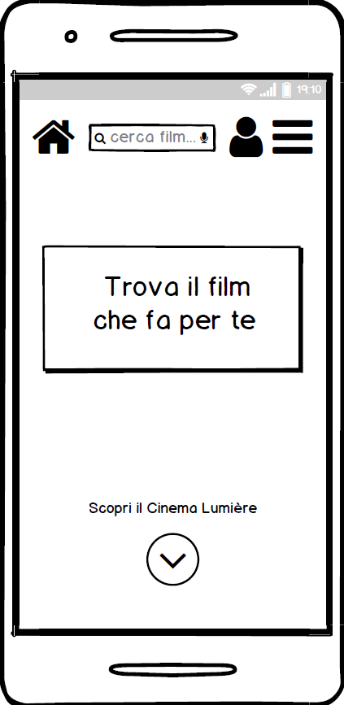
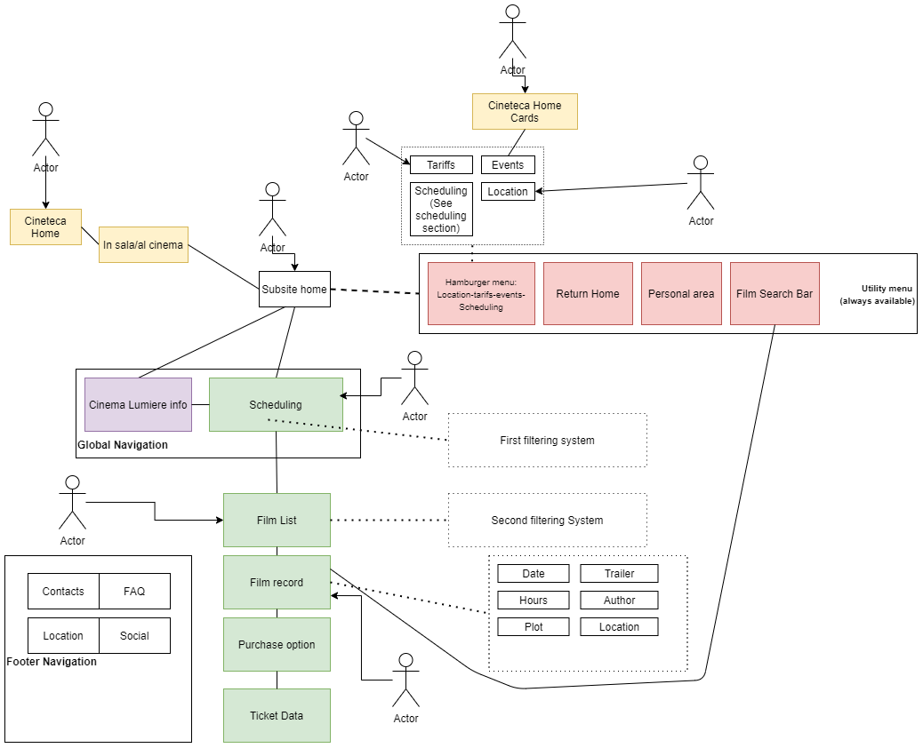
The design process: from blueprints to wireframes
Notes:
matti, descrizioni dei blueprint

Slide 9
Users feedback
Even if our tests were conducted on a not fully implemented prototype, 100% of the tested users were able to carry out relevant tasks: this result is impressive when compared to the metrics collected for our competitor analysis, that only reached 44%.
The most positive feedback is the users satisfaction, something that we could directly see with our own eyes while they were using the prototype in such an engaging way and showing a behavior directed to discover more. They also filled in a system usability scale questionnaire where they rated the website with the most positive votes, scoring 96%.
Notes:
fra

Slide 10
Further developments
Desktop website UX design
Complete Cineteca website redesign
Deeper research on the younger user segment to understand why they are less performing in the tasks, since we saw in the tests a correlation between age and performance
Notes:
teo

Slide 11
Thank you!
Notes:
teo

